Slide 1
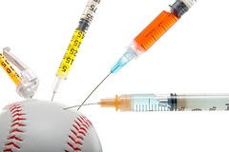
Human Growth Hormone
Cheating the game
by: Doug Riddell

Slide 2
My stance
HGH and other performance enhancing drugs are unhealthy for major league baseball players
major league baseball needs to put an hgh testing policy into effect

Slide 3
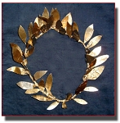
history
From 776 BC to 393 BC ancient Greek athletes were known to take performance enhancing drugs.
The ancient Olympic champions were professionals who competed for huge cash prizes as well as olive wreaths. Most forms of what we would call cheating were perfectly acceptable to them.
There is evidence that they gorged themselves on meat, not a normal dietary staple of the Greeks, and experimented with herbal medications in an effort to enhance their performances.
These athletes also drank wine potions, used halucinogens and ate animal hearts or testicles.

Slide 4
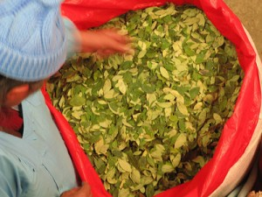
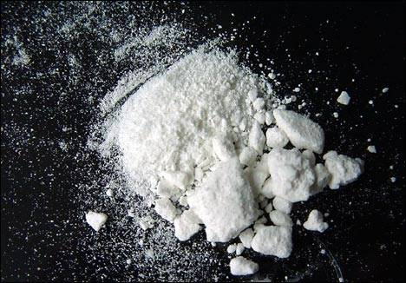
history
In the late 19th century, modern applications of drug use in sports began with preparations made from the coca leaf, the source of cocaine and related alkaloids.
Vin Mariani, a widely used mixture of coca leaf extract and wine, was even called “the wine for athletes”. It was used by French cyclists and also by a champion lacrosse team.
Coca and cocaine were popular because they staved off the sense of fatigue and hunger brought on by prolonged exertion.

Slide 5
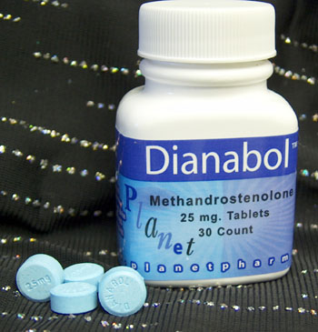
history
in 1958, the "Godfather of Steroids," Dr. John Bosley Zieglar, creates an anabolic steroid called Dianabol that is released by Ciba Pharmaceuticals with FDA approval.
Dr. Zieglar noted the success of the Russian weightlifting team due to the use of testosterone in 1954 and began experimenting on US weightlifters.
His creation synthesizes the strength-building properties of testosterone while minimizing the negative health effects.
Close to his death in 1983, Dr. Zieglar speaks out against his invention and says he wishes he had never created the anabolic steroid after seeing athletes abuse the drug

Slide 6
history
hgh was first isolated in 1956, and In 1958, an endocrinologist at the New England Medical Center first injected the hormone in a growth-stunted child, and the child soon began to grow.
Thousands of growth-stunted children with HGH-deficiency were treated in the decades that followed, using HGH derived from the pituitary glands of human cadavers.
Treatment of HGH-deficient children ceased in the 1980s because biological contamination caused a few of the children tragically to become infected with Creutzfeldt-Jakob disease (CJD), known today as "mad cow" disease.

Slide 7
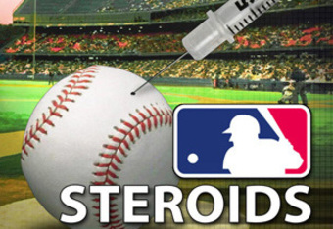
history
Just over a decade later, in 1969, Sports Illustrated produces a three-part investigation about performance-enhancing drugs in sports.
Sources predict that the use of such drugs will eventually explode into an epidemic.
Says former Los Angeles Dodgers team doctor Robert Kerlan, "The excessive and secretive use of drugs is likely to become a major athletic scandal, one that will shake public confidence in many sports just as the gambling scandal tarnished the reputation of basketball"

Slide 8
Science and technology
HGh is synthesized and secreted by the pituitary gland, which is located in the center of the brain.
Somatotroph cells located in the pituitary gland perform this synthesize-and- secrete function.
HGH is made up of 191 amino acids and the body starts producing it just after birth.
after its secretion , it is soaked in by the liver, which then converts it into growth elements that interact with the body’s cells.
These growth elements instruct the cells about when they should be active and when it is time to deactivate.
If HGH does not communicate and interact with the cells, then their reproduction and function slows down.
The body is host to optimum and maximum HGH levels between the age of 21 and 30 years.

Slide 9
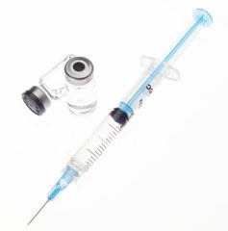
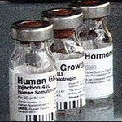
Science and technology
For growth hormone products such as the injectible form, the products are made with a recombinant form of growth hormone identical to the kind found in the human body.
The recombinant growth hormone used is made by taking DNA that contains GH 191 single chain amino acids and incorporating it into a living purified cell culture synthesized from plant matter.
Over a period of time, the growth hormone pattern develops in the culture medium and the finished product, in the form of a powder, is now an exact duplication of HGH.

Slide 10
Science and technology
If you look at all the studies that have been done on HGH injections you get the following list of benefits:
8.8% increase in muscle mass on average after six months, without exercise
14.4% loss of fat on average after six months, without dieting
Higher energy levels
Enhanced sexual performance
Regrowth of heart, liver, spleen, kidneys and other organs
Greater cardiac output
Superior immune function
Increased exercise performance
Better kidney function
Lowered blood pressure
Improved cholesterol profile, with higher HDL and lower LDL
Stronger bones
Faster wound healing
Younger, tighter, thicker skin
Hair regrowth
Wrinkle removal
Elimination of cellulite
Sharper vision
Mood elevation
Increased memory retention
Improved sleep

Slide 11
Health risks
the remarkable benefits of HGH treatment are not risk-free. The use of HGH injections or supplements can produce some disturbing side effects.
Some of these side effects include:
enlarged heart or kidneys
onset of diabetes
hypoglycemia
carpal tunnel syndrome
stiff muscles and joints
numbness in the hands
Nightmares
fatigue
high blood pressure
tenderness or pain at the site of injection
cardiovascular problems
an increased risk of arthritis
glucose intolerance
colon polyps
skin growths
excessive sweating
serious headaches
Heavy and prolonged growth hormone use can lead to abnormal bone growth in the face, head, hands and feet

Slide 12
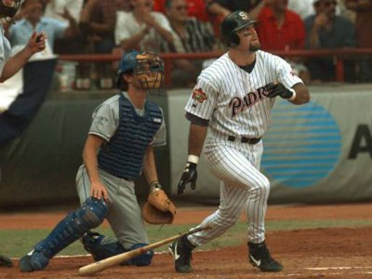
Health risks
One study did show a possible link to cancer, however, it has not been proven in humans, only in mice. Research has shown that mice with high levels of growth hormone actually live shorter lives than those with low levels.
In 2002, Ken Caminiti, who retired from baseball after the 2001 season, admitted in the June 3 issue of Sports Illustrated that he was using steroids when he won the 1996 National League MVP award, adding, "I've made a ton of mistakes. I don't think using steroids is one of them." He estimates that at least half of his fellow big leaguers are regular juicers. Two years later Caminiti died at the age of 41 from a heart attack

Slide 13
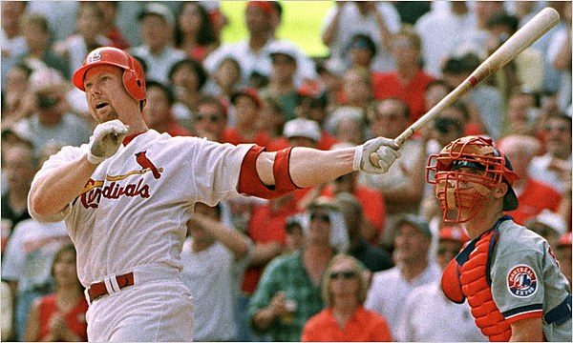
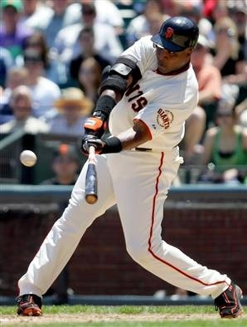
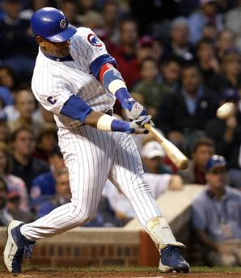
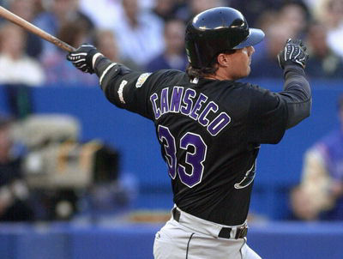
Baseball’s steroid era
Mlb’s steroid era is considered to be from 1996 through 2007. during this time period, numerous players have been found guilty of using hgh and other performance enhancing drugs. The big names mainly associated with this era are:
Mark mcgwire
Sammy sosa
Jose canseco
Barry bonds

Slide 14
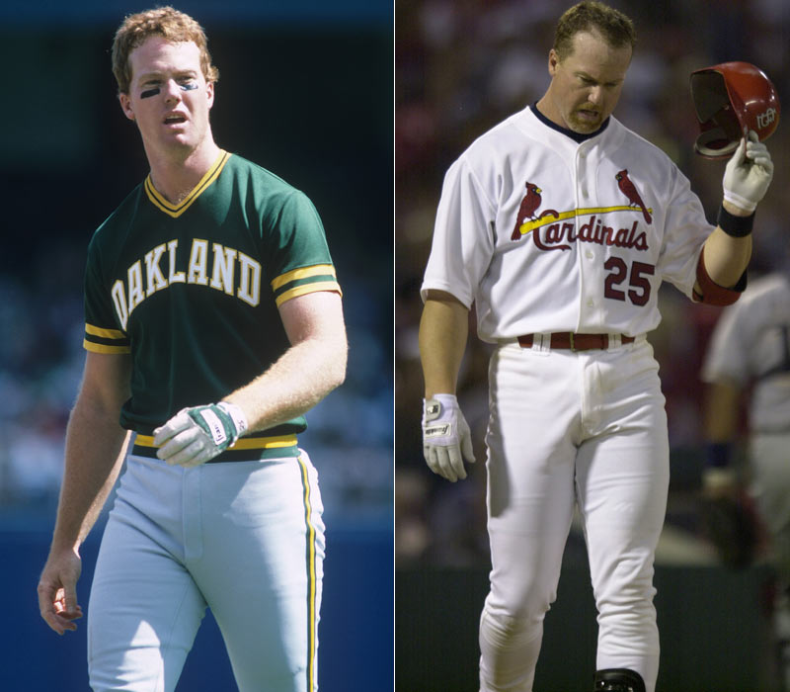
Baseball’s steroid era
In 2010, Mark McGwire finally came clean, admitting he used steroids when he broke baseball's home run record in 1998, but he also said he didn't need performance-enhancing drugs to hit the long ball. McGwire said in a statement that he used steroids on and off for nearly a decade. However, he disputed that the drugs gave him more power to hit homers. "I was given a gift to hit home runs," he told Bob Costas on MLB Network. He told Costas that studying pitchers and making his swing shorter led to his increase in home runs and that he could have hit them without performance enhancing drugs. When asked if he really believed that, he responded, "I truly believe so," McGwire said. "I believe I was given this gift. The only reason I took steroids was for health purposes" mcgwire broke the old homerun record of 61 by roger maris by hitting 70 in 1998.

Slide 15
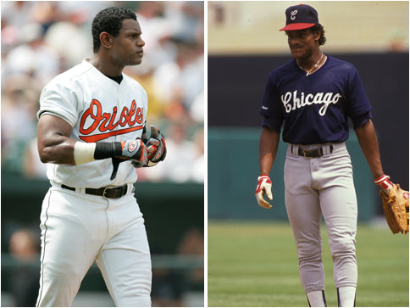
Baseball’s steroid era
In a 2009 article, the ny times reported that Sammy Sosa tested positive for a performance-enhancing drug in 2003. Sosa is one of 104 players who tested positive in baseball's anonymous 2003 survey. He is sixth on baseball's career home run list with 609. in 2003, baseball did not have penalties for the first-time use of performance-enhancing drugs, therefore Sosa was never penalized for the failed test.

Slide 16
Baseball’s steroid era
In his book “Juiced”, Jose Canseco writes about his 16-year career as a Major League ball player, and he says that from his first season, to his last in 2001, he used illegal anabolic steroids and human growth hormone. in 1988, Canseco hit 42 home runs and stole 40 bases. It was a feat never seen before. Throughout his book, Canseco names numerous players who were involved in steroid use, including McGwire, and says that at least half of the players in the league were regular users .

Slide 17
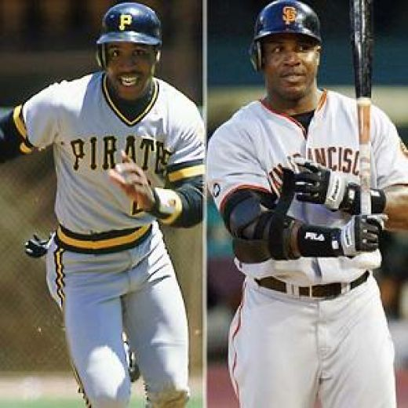
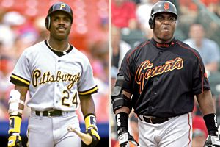
Baseball’s steroid era
when barry Bonds broke Mark McGwire's single-season home-run record in 2001 by belting 73, Bonds was using two designer steroids referred to as the Cream and the Clear, as well as insulin, human growth hormone, testosterone decanoate (a fast-acting steroid known as Mexican beans) and trenbolone, a steroid created to improve the muscle quality of cattle. Bonds gulped as many as 20 pills at a time and was so deeply reliant on his regimen that he would start cycles even when he was not due to begin one.

Slide 18
The opposition
It is very difficult to find someone who opposes the idea that performance enhancing drugs aren’t bad for you, but what you will find are those who say that the drugs don’t actually enhance performance. The thought is that yes, the athlete may become stronger, but if he already can’t hit the baseball, he won’t be able to hit a baseball any better by taking the drugs. Therefore, the drugs aren’t enhancing performance.
E.C. Percy, a physician of 25 years, says that after 25 years of intense exposure to all levels professional and amateur athletes, he believes that doping is not by any means as serious a problem on this continent as it is made to appear to the press. The athletes and the lay press are responsible for the false impression that certain substances will enhance an athlete’s performance

Slide 19
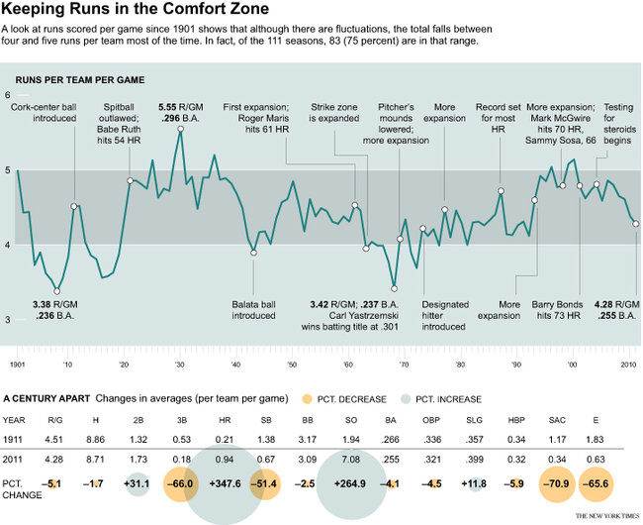
The opposition

Slide 20
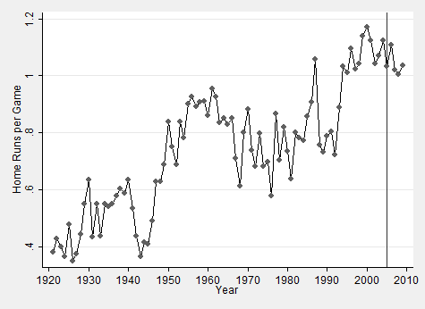
The opposition
In 1993, home runs per game jumped by 23%, and in 1994 they jumped 16%. Since that time, the average absolute change in home run rates has averaged about 5% and maxed out at 9%.

Slide 21
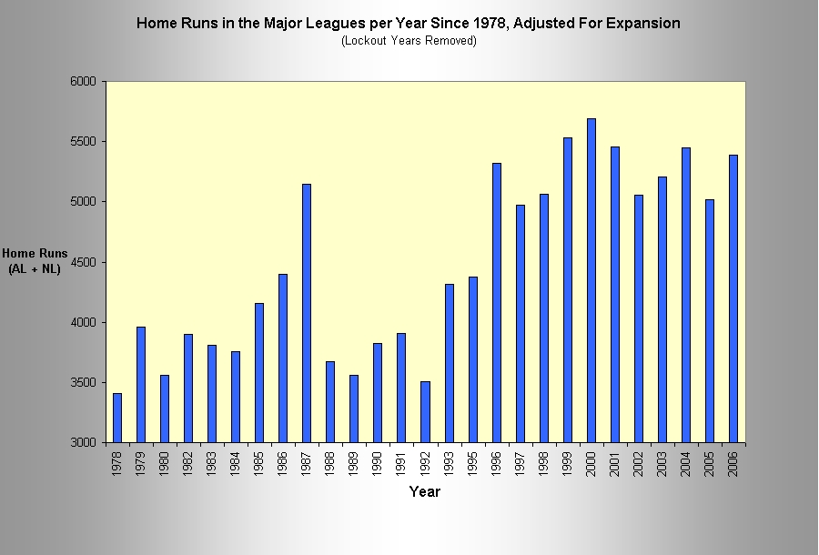
The opposition
The graph depicts an increase in home run totals in the league. The massive numbers are from the “Steroid Era” of 1996-2007 and the lower numbers occurred in the “Dead Ball Era” of 1900-1920.

Slide 22
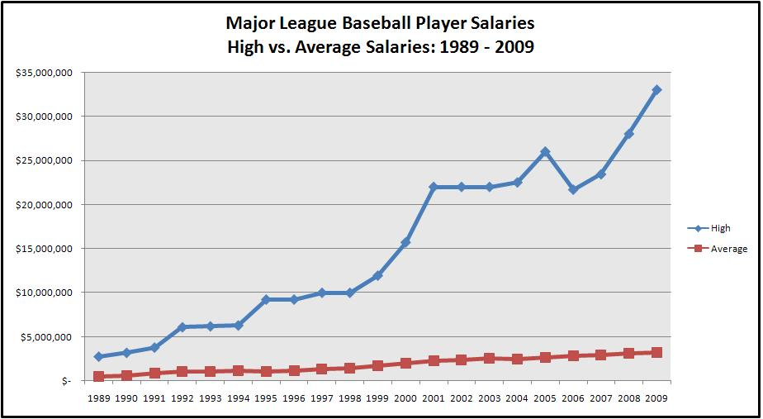
Economic factors
The steroid era in MLB has an enormous effect on the economics of the game. MLB player salaries drastically increased during the height of the home run chases of McGwire, Sosa, and eventually Bonds. The beginning of the steroid era can be traced back to the late 1990′s when the salaries earned by the highest paid players in the league began to dramatically outpace the average Major League salary. From 1999 to 2009, the highest paid player in Baseball was associated with steroids in some way. Five of the top ten highest paid players in the game in 2007 turned out to be associated with steroids as well.

Slide 23
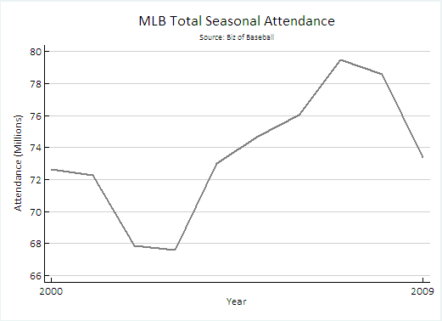
Economic factors
A second measure of the economics of the steroid era is to look at the total seasonal attendance from prior to the steroid scandal being revealed through the 2009 season. The graph appears to show a decline in attendance following the exposure of the steroid scandal. Without a doubt, the news of the scandal turned many fans away from the game and it directly affected the ticket sales of games during that time. However, just like the times in the past when player lockouts turned fans away, the fans began to gradually come back, eventually peaking out around the 2007 season.

Slide 24
political factors
Following the fallout of the steroid scandal, On October 22, 2004, President Bush signed into law the Anabolic Steroid Control Act of 2004 that the U.S. Congress passed earlier in the month. The bill added hundreds of steroid-based drugs and precursors to the list of anabolic steroids that are classified as Schedule III controlled substances, which are banned from over-the-counter sales without a prescription. By virtue of MLB's own agreement with the union, all of the drugs banned by Congress are now on baseball's own banned list.
Eventually Congress still pressed MLB on the steroid issue, and demanded that there be an investigation into the use of steroids in baseball. informally known as the "Mitchell Report", it was the result of former Democratic United States Senator from Maine, George J. Mitchell's 21-month investigation into the use of anabolic steroids and HGH in Major League Baseball.
The 409-page report covers the history of the use of illegal performance-enhancing substances by players and the effectiveness of the MLB Joint Drug Prevention and Treatment Program. The report also advances certain recommendations regarding the handling of past illegal drug use and future prevention practices. In addition, the report names 89 MLB players who are alleged to have used steroids or other performance-enhancing drugs. Since the congressional hearing, baseball owners and players toughened their drug program twice, increasing the penalty for a first steroids offense from 10 games to 50 games in November 2005 and strengthening the power of the independent administrator in April 2008.

Slide 25
legal factors
Selling growth hormone without a prescription can land you in prison for five years and carries a $250,000 fine.
Cultural/social factors
One of the biggest cultural factors surrounding the steroid era is whether or not the statistics from those players who have admitted use or been caught through testing should be included in the record books. If so, should they have an asterisk next to their names to indicate they were users?
In light of the latest accusations of Barry Bonds' steroid use, should his records and awards stand?
Yes |  | 17% | 20346 votes
Yes, with an asterisk |  | 19% | 23622 votes
No, wipe them out |  | 64% | 77984 votes
Total: 121952 votes Sports Illustrated

Slide 26
Future implications
MLB Commissioner Allan H. (Bud) Selig announced in 2010 that Minor League players will be subject to random blood testing for the detection of human growth hormone under Major League Baseball's Minor League Drug Prevention and Treatment Program. Major League Baseball is the first United States professional sports league to conduct blood testing.
Since Minor League players are not members of the Players Association, blood testing for HGH is not a subject for collective bargaining.
The current collective bargaining agreement does not call for testing, however it expires in december of this year. When a new agreement is established, it is a must for MLB to ensure that blood testing is included, or we may never be able to eliminate the problem.

